Slide 1
Online Airline Reservation System
Simaranjit Singh
Sukhjinder Singh Kalsi
Mandeep Singh
Manpreet Brar
Dec,14,2015

Slide 2
Application features
A user may query the airport, all flights information between two locations on a specific day.
A user may make a reservation for available seats.
A user may cancel a previous reservation.
A user may pay for the ticket online by providing the credit card to the system.

Slide 3
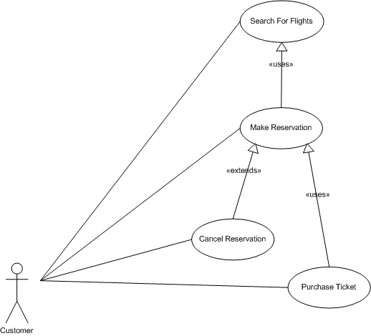
Use case

Slide 4
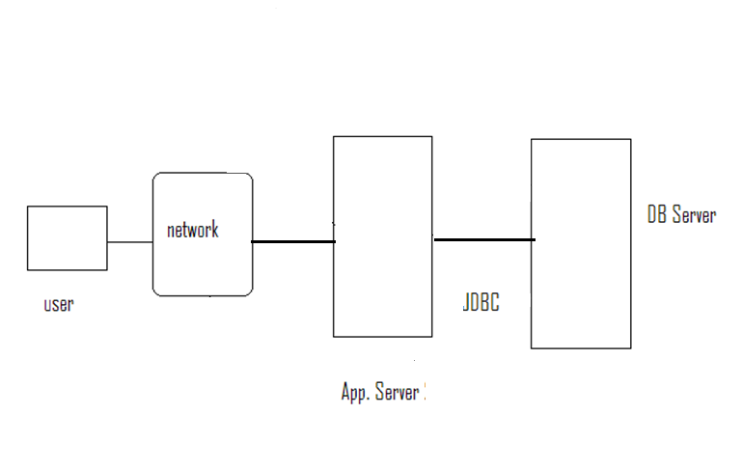
Deployment View

Slide 5



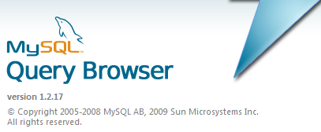


Technologies

Slide 6
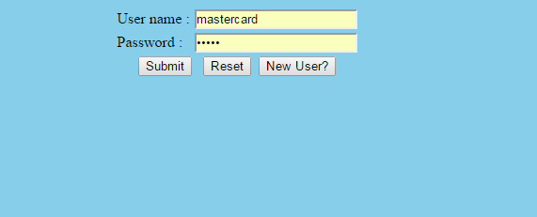
Access To Application With Login
A valid user must be login to Airline reservation system.

Slide 7
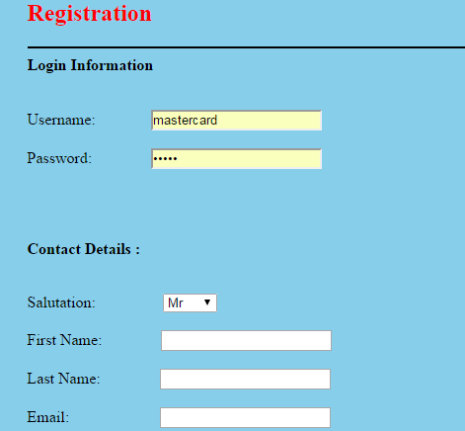
Registration Page

Slide 8
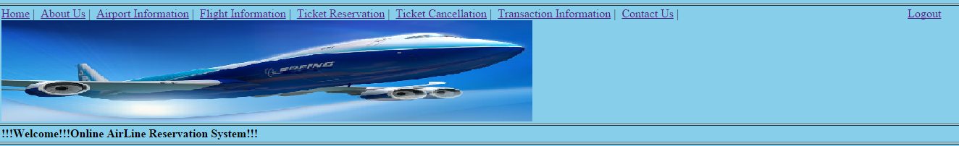
Home Page – After Login

Slide 9
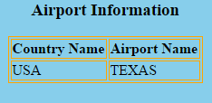
Detailed Airport Information

Slide 10
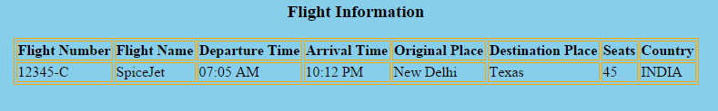
Detailed Flight Information

Slide 11
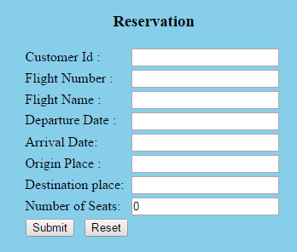
Reservation Page

Slide 12
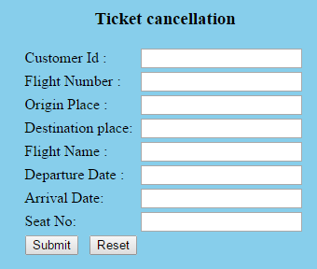
Cancellation Page

Slide 13
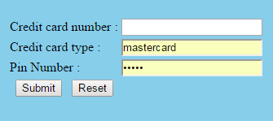
Transaction Page

Slide 14

Questions

